Slide 1
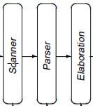
Construct Scanners
source
code
Front End
IR
Optimizer
IR
Back End
target
code
Last Lecture: Specify microsyntax with
regular expressions (REs)
deterministic finite automata (DFAs)
Today: nondeterministic finite automata (NFAs)
RE -> NFA: Thompson’s algorithm

Slide 2
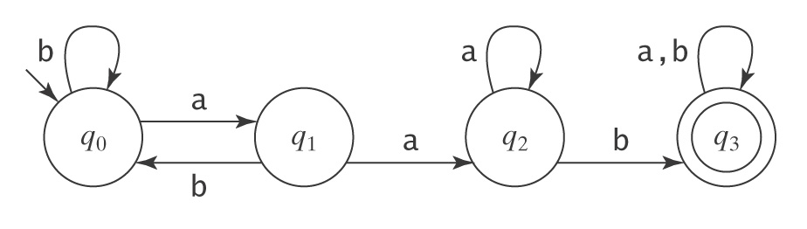
Design DFAs
L = {w ∈ {a, b}* : w contain the substring aab}.
L = {w ∈ {a, b}* : w has a postfix aab}.
q₂
q₃

Slide 3
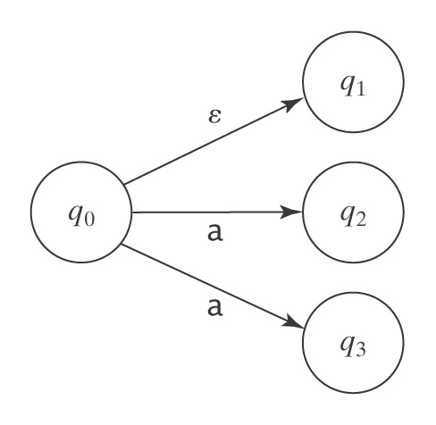
NFA
Can a finite automaton have multiple transitions out of a single state on the same character?
Yes, we call such an FA a Nondeterministic Finite Automaton
And, yes, the NFA is a truly odd notion … but a useful one

Slide 4
Non-deterministic Finite Automata
An NFA accepts a string x iff ∃ a path though the transition graph from s₀ to a final state such that the edge labels spell x, ignoring ε’s
Transitions on ε consume no input
To “run” the NFA, start in s₀ and guess the right transition at each step
Always guess correctly
If some sequence of correct guesses accepts x then accept

Slide 5
NFA Example
“accept”
“reject”
aa is accepted by the NFA

Slide 6
DFA vs NFA
L = {w ∈ {a, b}* : w contain the substring aab}.
a, b
a, b
a
a
b
L = {w ∈ {a, b}* : w has a postfix aab}.
a, b
q₂
q₃
a
a
b

Slide 7
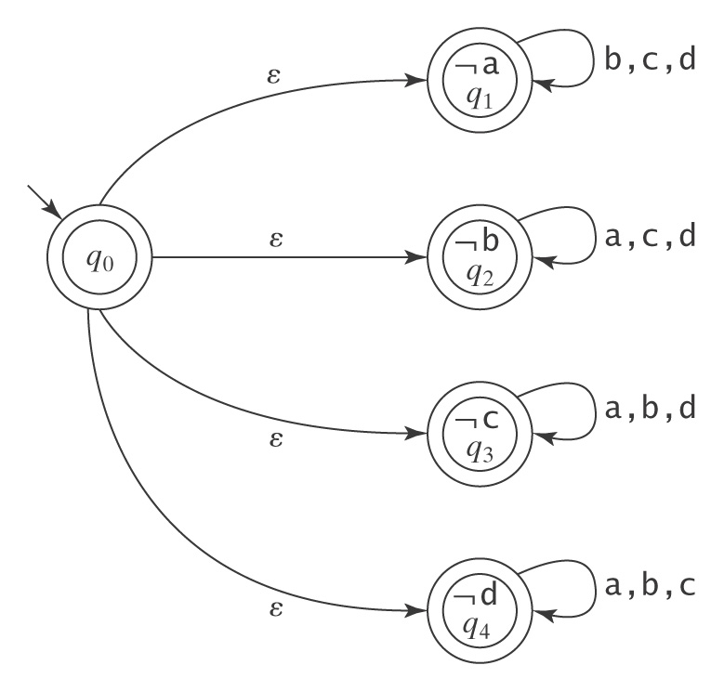
NFA
Let Σ = {a, b, c, d}. Let L_{Missing} = {w : there is a symbol a_{i} ∈ Σ not appearing in w}

Slide 8
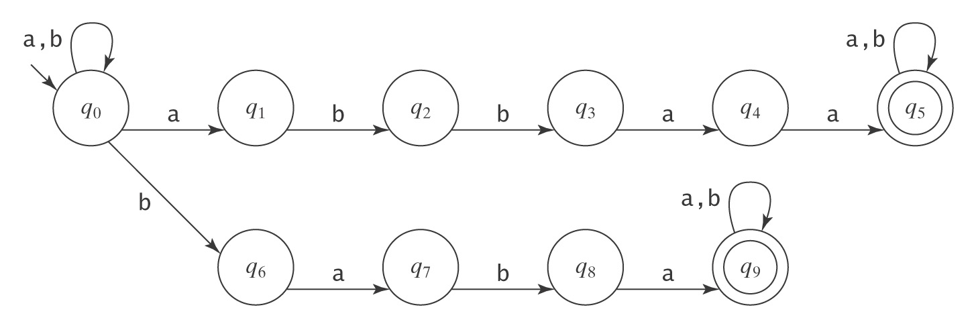
NFA Example: Multiple Keywords
L = {w ∈ {a, b}* : ∃x, y ∈ {a, b}*
((w = x abbaa y) ∨ (w = x baba y))}.

Slide 9
Non-deterministic Finite Automata
NFAs are more intuitive
NFAs can make a transition without consuming an input symbol
A state in NFA can have two or more transitions on an input symbol

Slide 10
Relationship between NFAs and DFAs
NFA & DFA are equivalent in ability to recognize languages
DFA can be simulated with an NFA
DFA is a special case of an NFA
DFA has no ε transitions
DFA’s transition function is single-valued
NFA can be simulated with a DFA (less obvious, but still true)
Simulate sets of possible states
Possible exponential blowup in the state space
Still, one state per character in the input stream

Slide 11
Non-deterministic Finite Automata
Why study NFAs?
They are the key to automating the RE→DFA construction
We can paste together NFAs with ε-transitions
NFA
ε
NFA
NFA
becomes an

Slide 12
Automating Scanner Construction
To convert an RE specification into code:
Write down the RE for the input language
Build a big, simple NFA
3 Systematically minimize the DFA
4 Turn it into code
Scanner generators
Lex and Flex work along these lines
Algorithms are well-known and well-understood
Key issue is interface to parser ¹
You could build one in a weekend!

Slide 13
The Plan for Scanner Construction
RE → NFA (Thompson’s construction)
Build a nondeterministic finite automaton (NFA) for each term in the RE
Combine them in patterns that model the operators
NFA → Minimal DFA
Option1: NFA → DFA→ Minimal DFA
NFA → DFA: Subset construction to build a DFA that simulates the NFA
DFA → Minimal DFA: Hopcroft’s algorithm
Option2: NFA → Minimal DFA
Brzozowski’s algorithm
DFA → RE
All pairs, all paths problem
Union together paths from s₀ to a final state
The Cycle of Constructions
minimal DFA
RE
NFA
DFA
Taken together, these constructions prove that DFAs and REs are equivalent.

Slide 14
RE → NFA using Thompson’s Construction
Key idea
NFA pattern for each symbol & each operator
Join them with ε moves in precedence order
S₀
a
S₁
S₀
b
S₁
S₀
a
S₁
ε
S₃
b
S₄
NFA for a
NFA for b
NFA for ab
S₁
a
S₂
ε
ε
ε
S₀
S₅
S₀
ε
S₁
a
S₃
ε
S₄
ε
S₃
b
S₄
ε
ε
NFA for a*
NFA for a | b
Precedence in REs:
Closure
Concatenation
Alternation
Ken Thompson, CACM, 1968

Slide 15
Example of Thompson’s Construction
Let’s build an NFA for a ( b | c )*
1. a, b, & c
2. b | c
3. ( b | c )*
S₀
a
S₁
S₀
b
S₁
S₀
c
S₁
S₁
b
S₂
ε
ε
S₀
S₅
ε
S₃
c
S₄
ε
ε
ε
S₂
b
S₃
ε
S₀
ε
S₁
S₆
ε
S₇
ε
S₄
c
S₅
ε
ε
Note that states are being renamed at each step.

Slide 16
Example of Thompson’s Construction
a ( b | c )*
Of course, a human would design something simpler ...
ε
ε
S₄
b
S₅
ε
S₀
a
S₁
ε
S₂
ε
S₃
S₈
ε
S₉
ε
S₆
c
S₇
ε
ε
b, c
a
But, we can automate production of the more complex NFA version ...
S₀
S₁

